Slide 1
Unit-3 Introduction to Cyber Security
Tools and Methods Used in Cybercrime
Presented By:
C Sharmila Suttur
Dept. of ECE
RIT

Slide 2

UNIT-3
Tools and Methods Used in Cybercrime

Slide 3

Introduction
As the Internet and computer networks are integral parts of information systems, attackers have in-depth knowledge about the technology and/or they gain thorough knowledge about it.
The basic stages of an attack are:
1. Initial uncovering:
In the first step called as reconnaissance, the attacker gathers information, as much as possible, about the target by legitimate means.
In the second step, the attacker uncovers as much information as possible on the company’s internal network.
2. Network probe: A “ping sweep” of the network IP addresses is performed to seek out potential targets, and then a “port scanning” tool is used to discover exactly which services are running on the target system.
3. Crossing the line toward electronic crime (E-crime): Now the attacker is toward committing what is technically a “computer crime” by exploiting possible holes on the target system.
4. Capturing the network: At this stage, the attacker attempts to “own” the network. The attacker gains a foothold in the internal network quickly and easily.
5. Grab the data: Now that the attacker has “captured the network,” he/she takes advantage of his/her position to steal confidential data, customer credit card information, deface webpages, alter processes and even launch attacks at other sites from your network.
6. Covering tracks: This is the last step in any cyber attack, which refers to the activities undertaken by the attacker to extend misuse of the system without being detected.

Slide 4
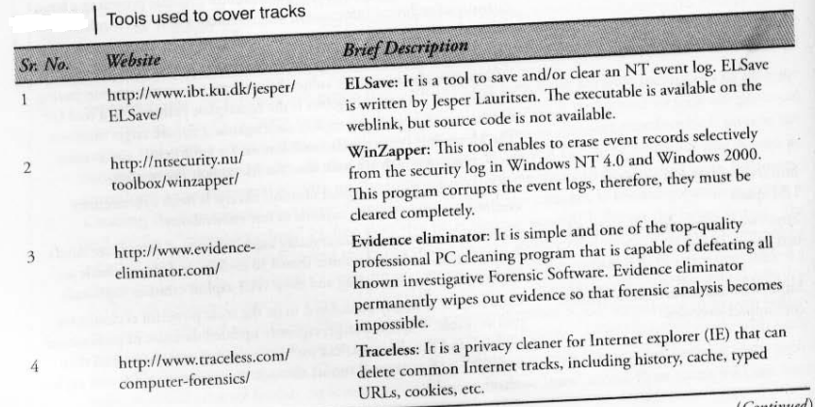
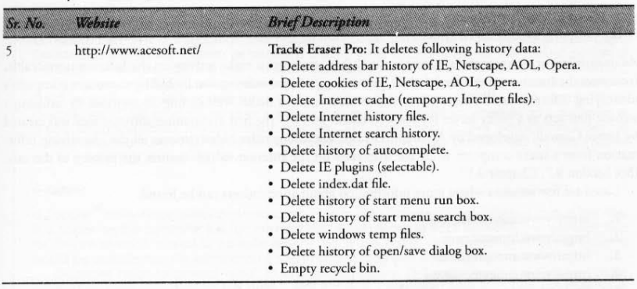

Slide 5
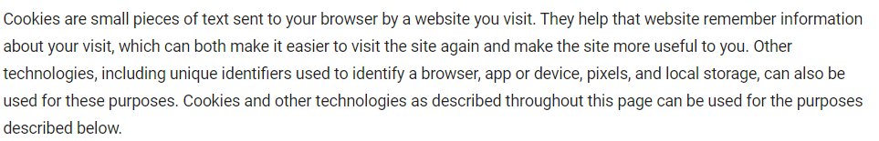
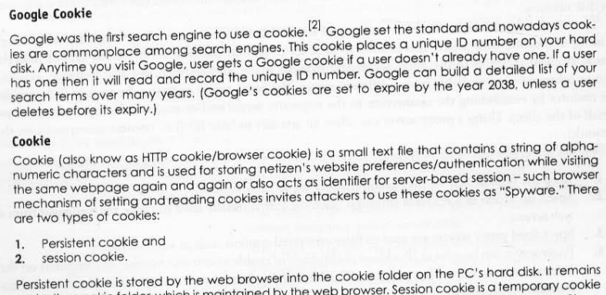

Slide 6
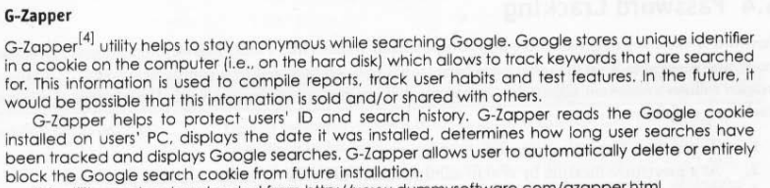

Slide 7
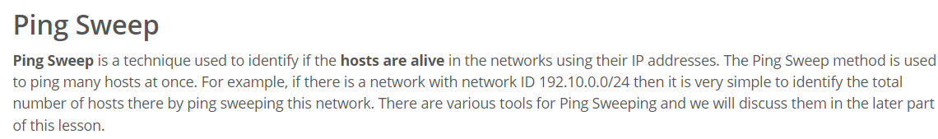
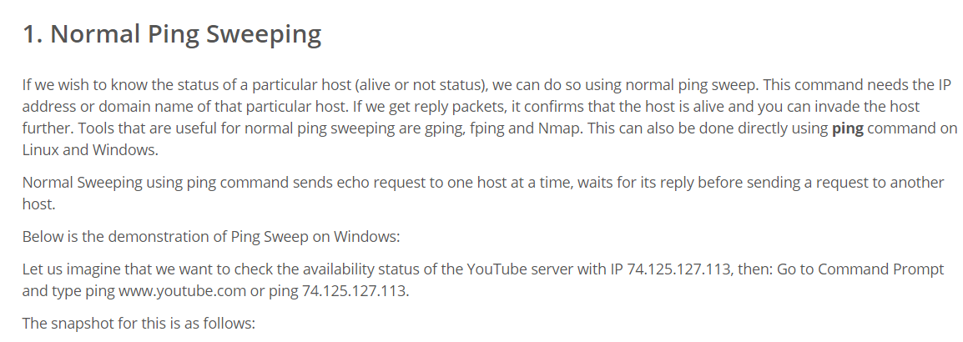

Slide 8
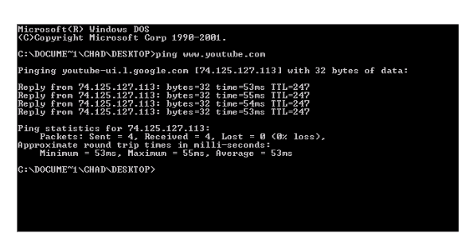

Slide 9
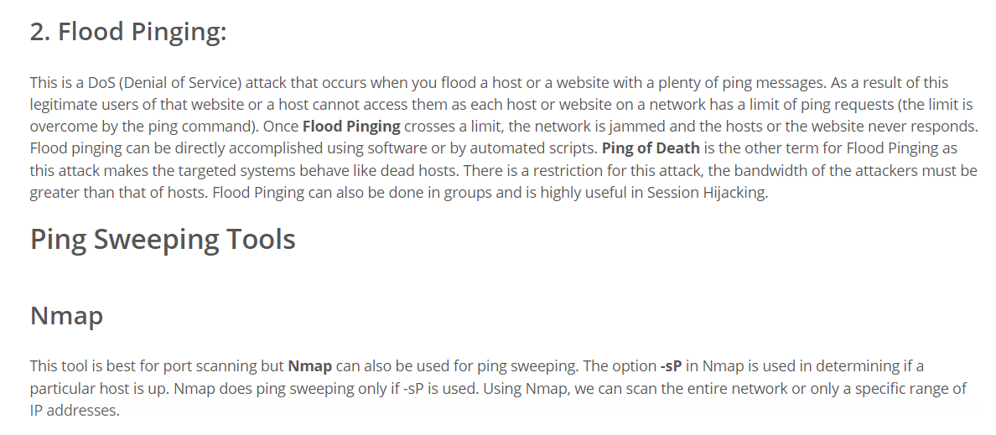

Slide 10
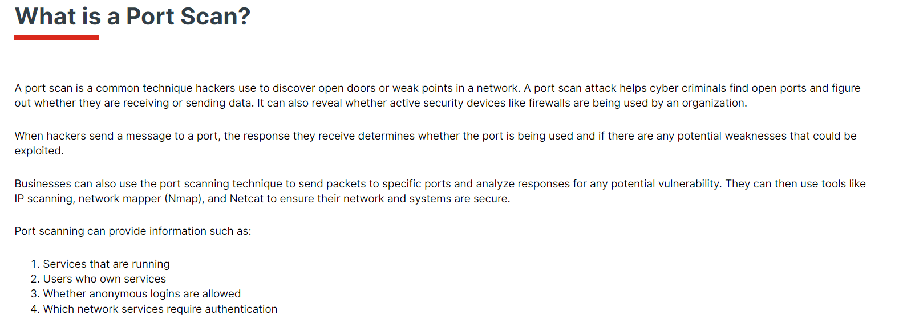

Slide 11
Proxy Servers and Anonymizers
Proxy server is a computer on a network which acts as an intermediary for connections with other computers on that network.
A proxy server has following purposes:
1. Keep the systems behind the curtain.
2. Speed up access to a resource (through “caching”).
3. Specialized proxy servers are used to filter unwanted content such as advertisements.
4. Proxy server can be used as IP address multiplexer to enable to connect number of computers on the Internet, whenever one has only one IP address.
An anonymizer or an anonymous proxy is a tool that attempts to make activity on the Internet untraceable.
It accesses the Internet on the user’s behalf, protecting personal information by hiding the source computer’s identifying information.
Phishing
Phishing is a fake or false e-mail which can infect systems with in addition to stealing personal and financial data.
How Phishing Works? <
Phishers work in the following ways: (1) Planning (decide the target), (2) Setup (create methods for delivering the message and to collect the data about the target), (3) Attack (phisher sends a phony message), (4) Collection (record the information of victims), (5) Identity theft and fraud (use the information that they have gathered to make illegal purchases or commit fraud).

Slide 12
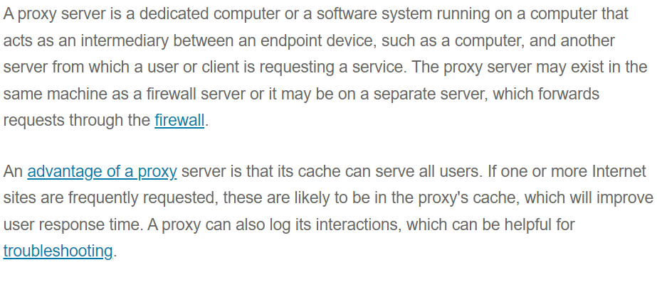
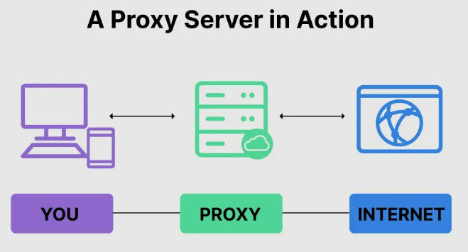
PROXY SERVER

Slide 13
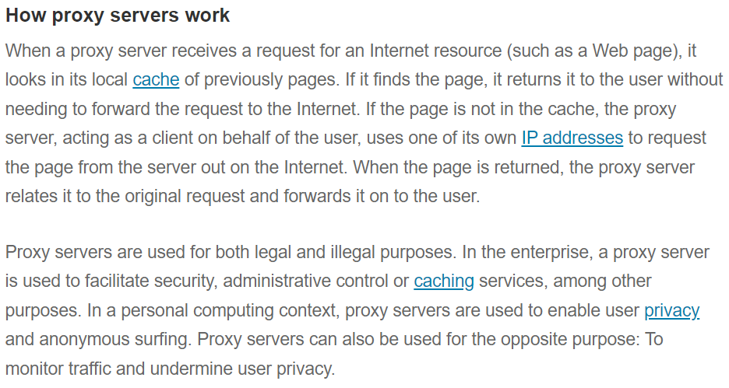
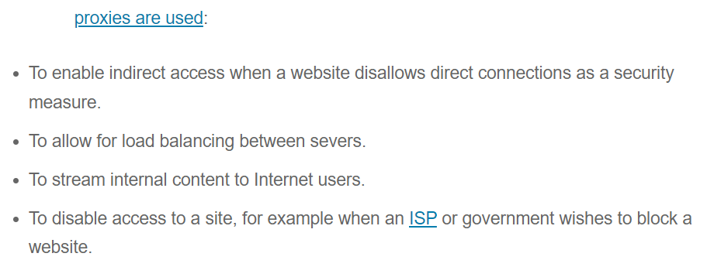

Slide 14
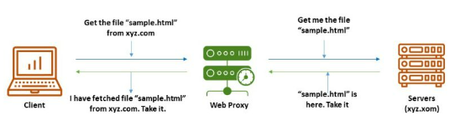

Slide 15
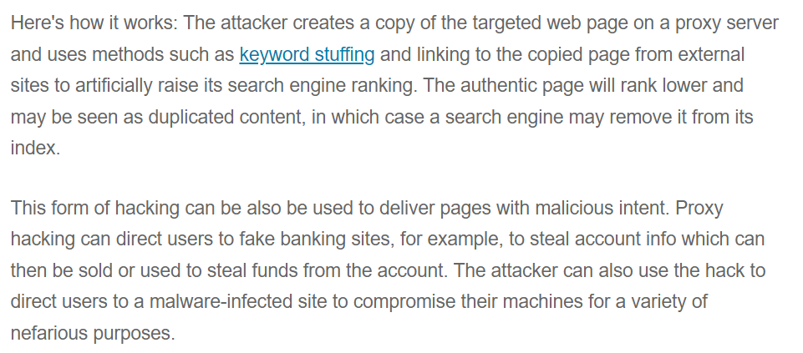
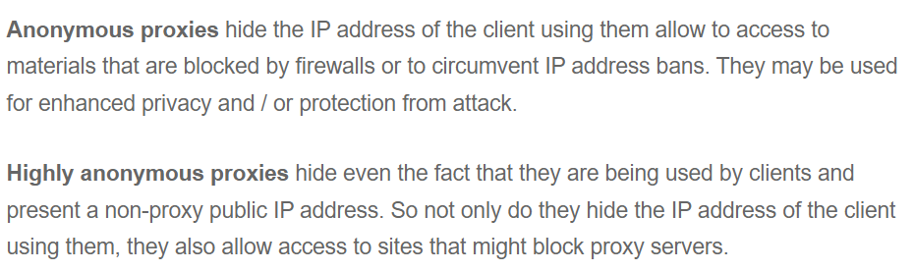
PROXY HACKING

Slide 16
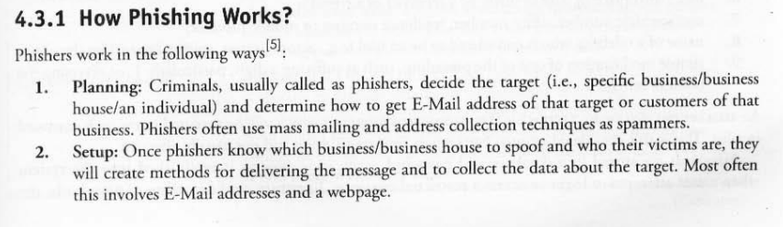
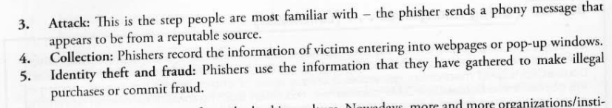

Slide 17
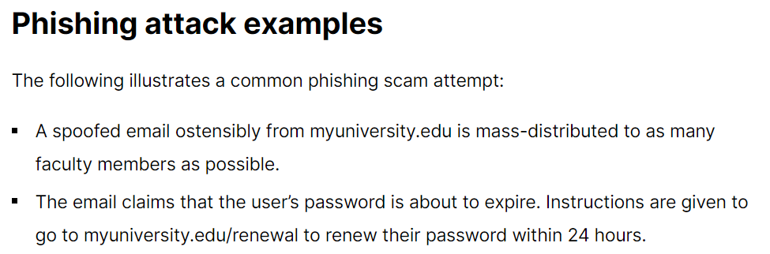
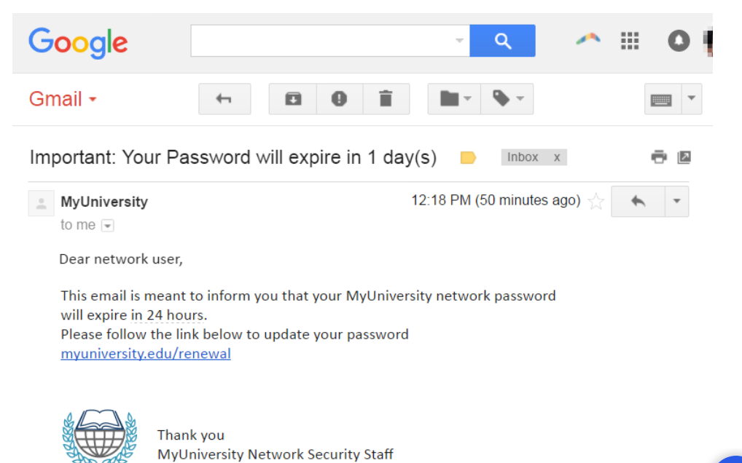

Slide 18
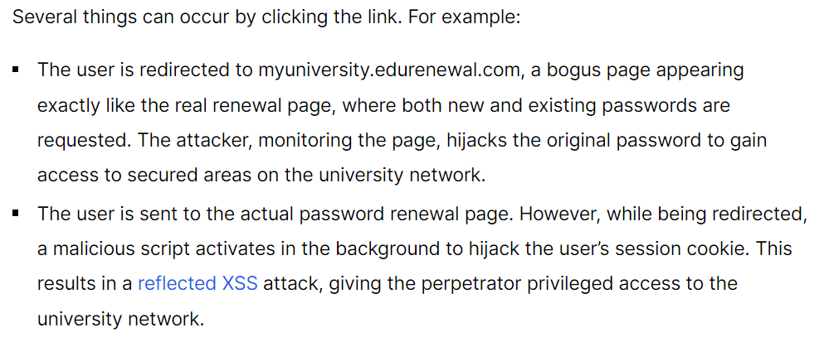

Slide 19
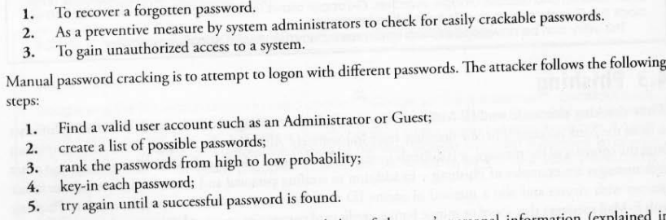
Password Cracking
The purpose of Password cracking is as follows:

Slide 20
Password Cracking (contd)
Password cracking is a process of recovering passwords from data that have been stored in or transmitted by a computer system. Examples of guessable passwords include:
1. Blank (none);
2. the words like “password,” “passcode” and “admin”;
3. series of letters from the “QWERTY” keyboard, for example, qwerty, asdf or qwertyuiop;
4. user’s name or login name;
5. name of user’s friend/relative/pet;
6. user’s birthplace or date of birth, or a relative’s or a friend’s;
7. user’s vehicle number, office number, residence number or mobile number;
8. name of a celebrity who is considered to be an idol (e.g., actors, actress, spiritual gurus) by the user;
9. simple modification of one of the preceding, such as suffixing a digit, particularly 1, or reversing the order of letters.
Password cracking attacks can be classified under three categories as follows:
1. Online attacks;
2. offline attacks;
3. non-electronic attacks (e.g., social engineering, shoulder surfing and dumpster diving).

Slide 21
shoulder surfing
In computer security, shoulder surfing is a type of social engineering technique used to obtain information such as personal identification numbers (PINs), passwords and other confidential data by looking over the victim's shoulder. Unauthorized users watch the keystrokes inputted on a device or listen to sensitive information being spoken, which is also known as eavesdropping.
A hidden camera allows the attacker to capture the whole login process and other confidential data of the victim, which ultimately could lead to financial loss or identity theft.^{[4]} Shoulder surfing is more likely to occur in crowded places because it is easier to observe the information without getting the victim's attention.^{[5]} There are two types of shoulder-surfing attack: direct observation attacks, in which authentication information is obtained by a person who is directly monitoring the authentication sequence, and recording attacks, in which the authentication information is obtained by recording the authentication sequence for later analysis to open the device. Apart from threats to password or PIN entry, shoulder surfing also occurs in daily situations to uncover private content on handheld mobile devices; shoulder surfing visual content was found to leak sensitive information of the user and even private information about third-parties.^{[6]}

Slide 22
This attack can be performed either at close range (by directly looking over the victim's shoulder) or from a longer range with, for example a pair of binoculars or similar hardware.^{[3]} Attackers do not need any technical skills in order to perform this method, and keen observation of victims' surroundings and the typing pattern is sufficient. In the early 1980s, shoulder surfing was practiced near public pay phones to steal calling card digits and make long-distance calls or sell them in the market for cheaper prices than the original purchaser paid. However, the advent of modern-day technologies like hidden cameras and secret microphones makes shoulder surfing easier and gives the attacker more scope to perform long range shoulder surfing.
In a real IoT digital world, in recent times, we are more about our personal information that is stored in smartphones. There is an urgent need to protect them from unauthorized access from other people. The first line of defense of a smartphone is its screen lock. Thus, many screen locking functions have been designated with a predefined objective of minimizing, if not eliminating the maximum chances of unauthorized access through attacks such as shoulder surfing.

Slide 23
DUMPSTER DIVING
In a dumpster diving attack, threat actors take the adage “One man’s garbage is another man’s treasure” to a whole new level. They could obtain sensitive information that allows them to infiltrate a network or copy a person’s identity.
Among the data that dumpster drivers can get from searching through your trash are:
Phone numbers of family members, friends, customers, and business associates
Access codes and passwords written on an innocent notepad
Credit card and bank account numbers
Blueprints of product designs
Printed drafts of business plans
Calendars and to-do lists for previous days
CDs, DVDs, and other portable storage devices

Slide 24
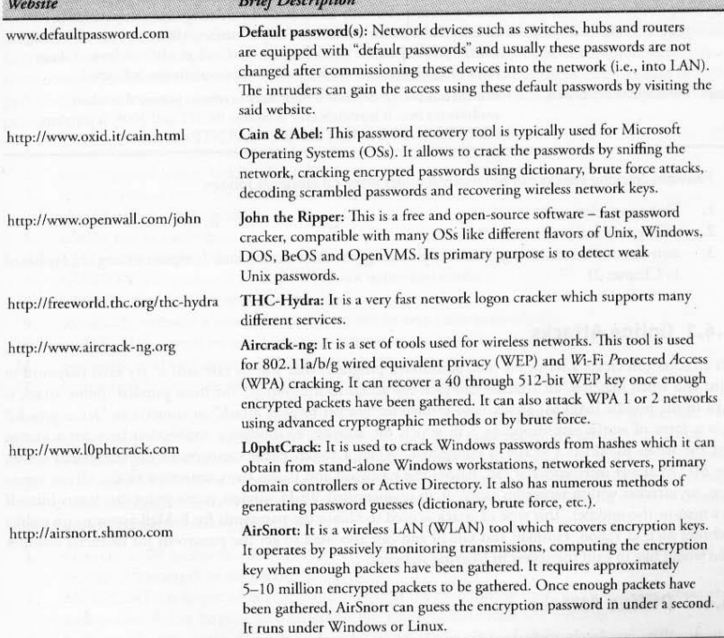
Password Cracking Tools

Slide 25
Online Attacks
The most popular online attack is man-in-the middle (MITM) attack, also termed as “bucket-brigade attack” or sometimes “Janus attack.”
It is a form of active eavesdropping in which the attacker establishes a connection between a victim and the server to which a victim is connected.
Offline Attacks
Offline attacks usually require physical access to the computer and copying the password file from the system onto removable media.
Strong, Weak and Random Passwords
A weak password is one, which could be easily guessed, short, common and a system default password that could be easily found by executing a brute force attack and by using a subset of all possible passwords.
A strong password is long enough, random or otherwise difficult to guess – producible only by the user who chooses it.
Random Passwords
Password is stronger if it includes a mix of upper and lower case letters, numbers and other symbols, when allowed, for the same number of characters.
The general guidelines applicable to the password policies are:
Keyloggers and Spywares
Keystroke logging- practice of noting (or logging) the keys struck on a keyboard.
Keystroke logger or keylogger is quicker and easier way of capturing the passwords and monitoring the victims’ IT savvy behavior.
It can be classified as software keylogger and hardware keylogger.

Slide 26
Man in the Middle Attack:
It is a cyberattack where the attacker secretly relays and possibly alters the communications between two parties who believe that they are directly communicating with each other, as the attacker has inserted themselves between the two parties. One example of a MITM attack is active eavesdropping, in which the attacker makes independent connections with the victims and relays messages between them to make them believe they are talking directly to each other over a private connection, when in fact the entire conversation is controlled by the attacker. The attacker must be able to intercept all relevant messages passing between the two victims and inject new ones. This is straightforward in many circumstances; for example, an attacker within the reception range of an unencrypted Wi-Fi access point could insert themselves as a man-in-the-middle. As it aims to circumvent mutual authentication, a MITM attack can succeed only when the attacker impersonates each endpoint sufficiently well to satisfy their expectations. Most cryptographic protocols include some form of endpoint authentication specifically to prevent MITM attack

Slide 27
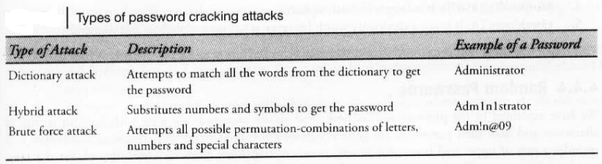

Slide 28
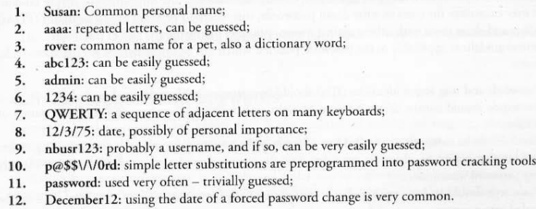
Examples of weak Passwords

Slide 29
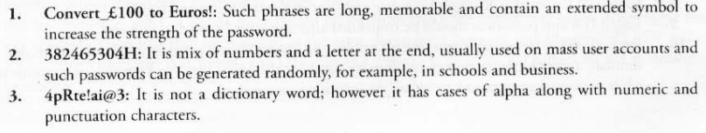
Examples of Strong Passwords

Slide 30
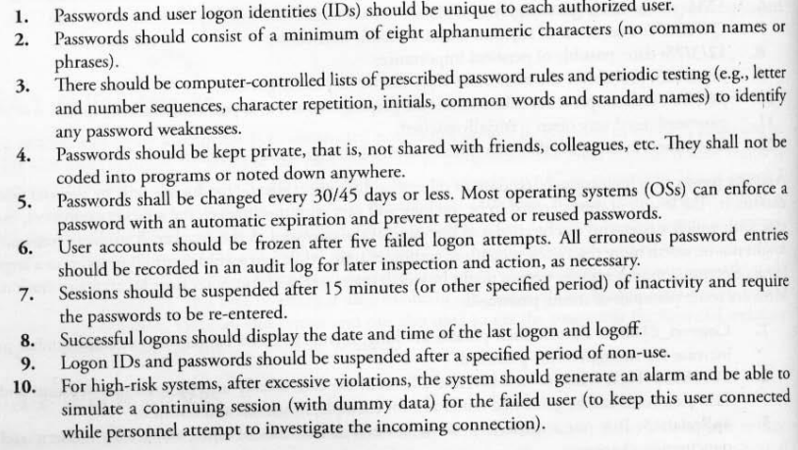
Random Passwords
The general guidelines applicable to the password policies are:

Slide 31
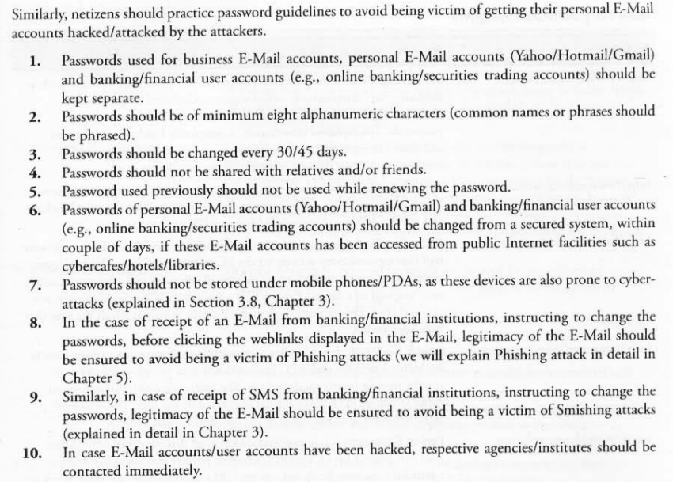
Password guidelines – To avoid Personal E-mail account attacks

Slide 32
Software Keyloggers
Software keyloggers are software programs installed on the computer systems which usually are located between the OS and the keyboard hardware, and every keystroke is recorded.
A keylogger usually consists of two files that get installed in the same directory: a dynamic link library (DLL) file and an EXEcutable (EXE) file that installs the DLL file and triggers it to work.
DLL does all the recording of keystrokes.
Hardware Keyloggers
Hardware keyloggers are small hardware devices connected to the PC and/or to the keyboard and save every keystroke into a file or in the memory of the hardware device.
These keyloggers look like an integrated part of such systems; hence, bank customers are unaware of their presence.
Cybercriminals install these on ATM machines, to capture ATM cards’ pins.
Antikeylogger
Antikeylogger is a tool that can detect the keylogger installed on the computer system and also can remove the tool. Advantages of using Antikeylogger are as follows:
1. Firewalls cannot detect the installations of keyloggers on the systems; hence, antikeyloggers can detect installations of keylogger.
2. This software does not require regular updates of signature bases to work effectively such as other antivirus and antispy programs.
3. Prevents Internet banking frauds.
4. It prevents ID theft.
5. It secures E-Mail and instant messaging/chatting.

Slide 33
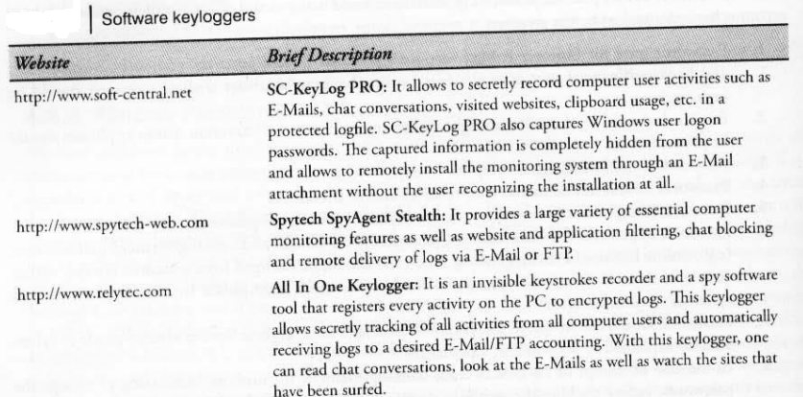

Slide 34
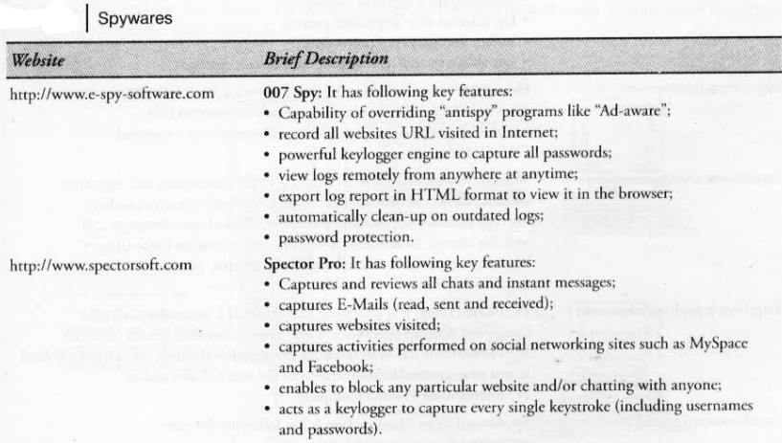
Spywares
Spyware is a type of malware, that is installed on computers, which collects information about users without their knowledge.
Spyware is malicious software secretly installed on the user’s personal computer.
Spywares such as keyloggers are installed by the owner of a shared, corporate or public computer on purpose to secretly monitor other users.

Slide 35
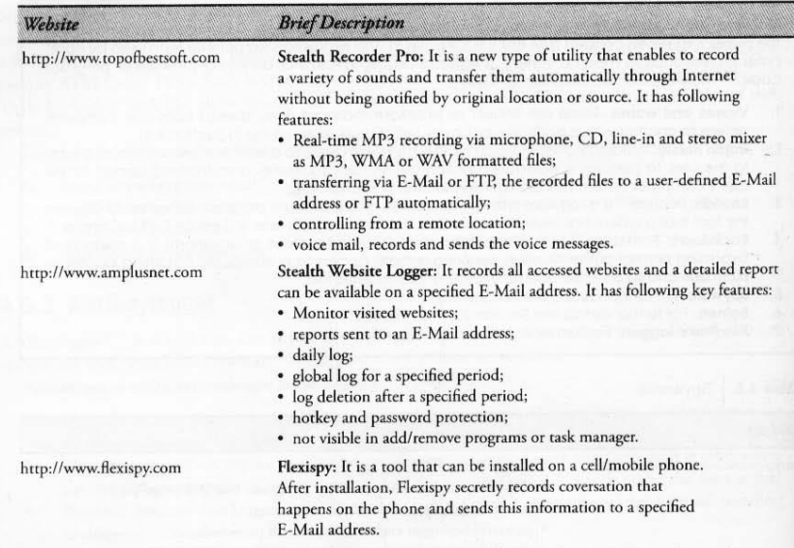
Spywares (contd)

Slide 36
Virus and Worms
Computer virus is a program that can “infect” legitimate programs by modifying them to include a possibly “evolved” copy of itself.
Viruses can take some typical actions:
1. Display a message to prompt an action which may set of the virus;
2. delete files inside the system into which viruses enter;
3. scramble data on a hard disk;
4. cause erratic screen behavior;
5. halt the system (PC);
6. just replicate themselves to propagate further harm.
Types of Viruses
Computer viruses can be categorized based on attacks on various elements of the system and can put the system and personal data on the system in danger.
Boot sector viruses
Program viruses
Multipartite viruses
Stealth viruses
Polymorphic viruses
Macroviruses
Active X and Java Control
A computer worm is a self-replicating malware computer program which uses a computer network to send copies of itself to other nodes (computers on the network) and it may do so without any user intervention

Slide 37
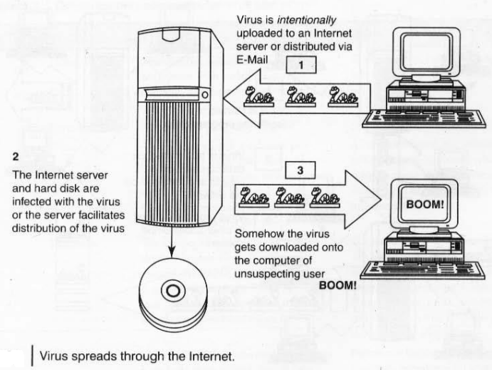

Slide 38
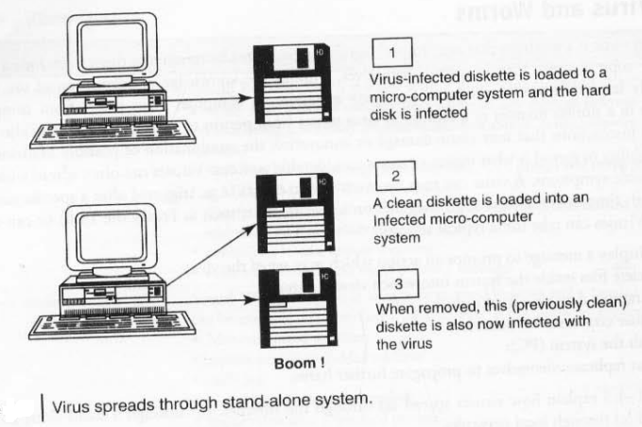

Slide 39
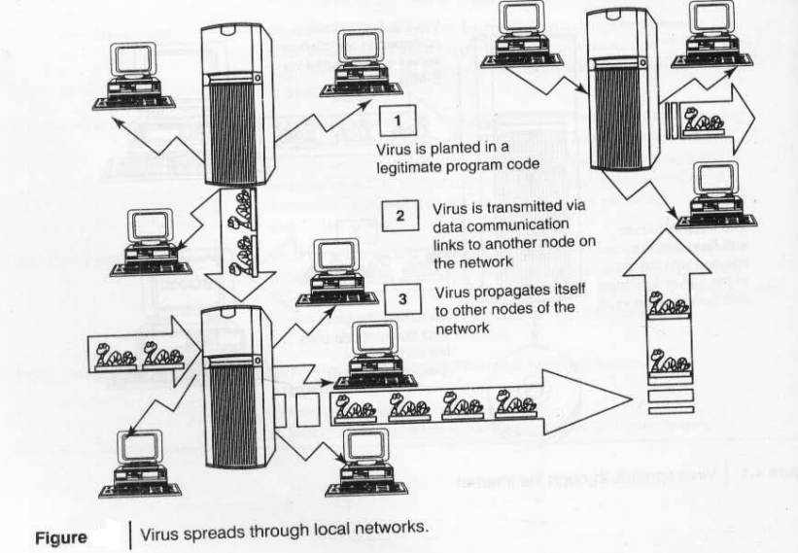

Slide 40
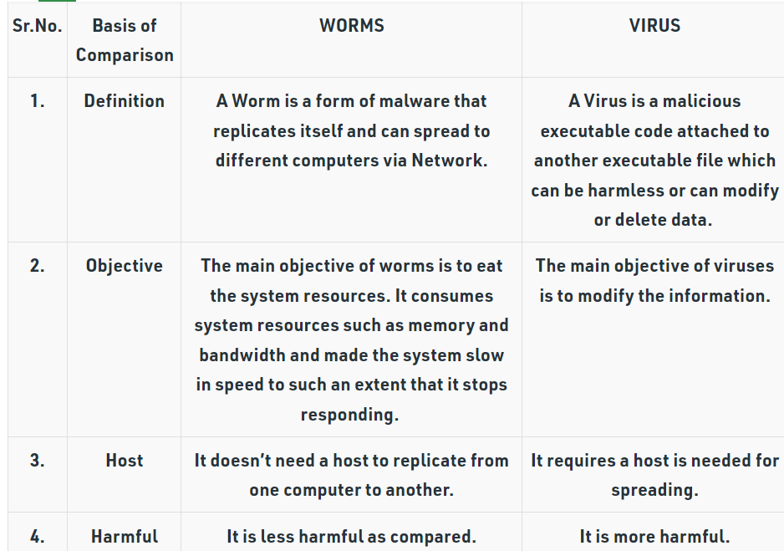

Slide 41
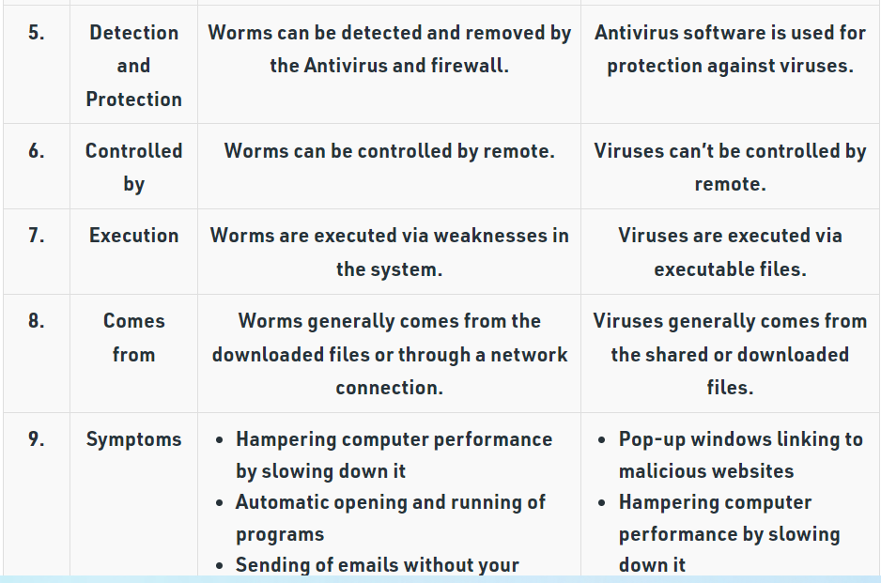

Slide 42
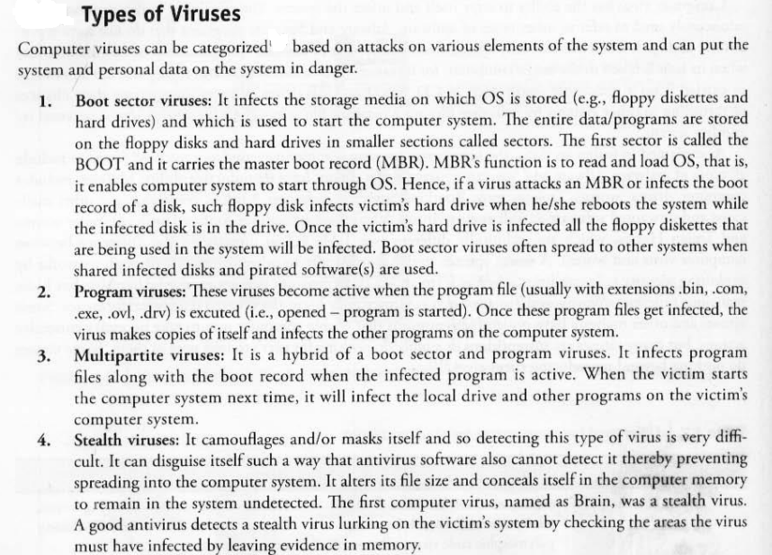

Slide 43
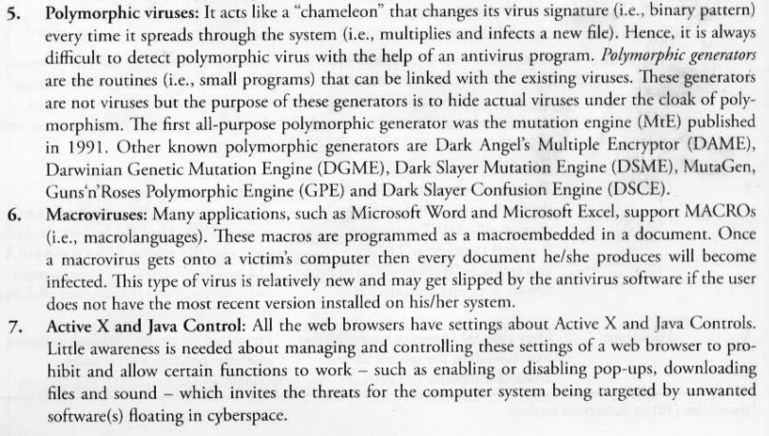
Types of viruses (contd)

Slide 44
Trojan Horse
Trojan Horse is a program in which malicious or harmful code is contained inside apparently harmless programming or data in such a way that it can get control and cause harm.
Trojans can get into the system in a number of ways, including from a web browser, via E-Mail or in a bundle with other software downloaded from the Internet.
Unlike viruses or worms, Trojans do not replicate themselves but they can be equally destructive.
On the surface, Trojans appear benign and harmless, but once the infected code is executed, Trojans kick in and perform malicious functions to harm the computer system without the user’s knowledge.
Backdoor
A backdoor is a means of access to a computer program that bypasses security mechanisms.
A programmer may sometimes install a backdoor so that the program can be accessed for troubleshooting or other purposes.
An attackers often use backdoors that they detect or install themselves as part of an exploit.
In some cases, a worm is designed to take advantage of a backdoor created by an earlier attack.
How to Protect from Trojan Horses and Backdoors
Stay away from suspect websites/weblinks
Surf on the Web cautiously
Install antivirus/Trojan remover software

Slide 45
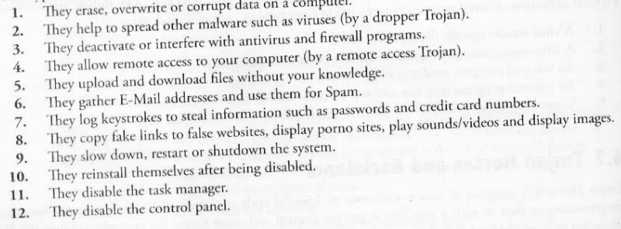
Some Typical examples of threats by Trojans are as follows:

Slide 46
Backdoor
In cybersecurity terms, a Backdoor Attack is an attempt to infiltrate a system or a network by maliciously taking advantage of software's weak point.
Backdoors allow the attackers to quietly get into the system by deceiving the security protocols and gain administrative access. It is similar to the real-life robbery in which burglars take advantage of the loopholes in a house and get a 'backdoor' entry for conducting the theft.
After gaining high-level administrative privilege, the cyber attackers could perform various horrendous tasks like injecting spyware, gaining remote access, hack the device, steal sensitive information, encrypt the system through ransomware, and many more.
Backdoors are originally meant for helping software developers and testers, so they are not always bad.
In one example of backdoor malware, cybercriminals hid malware inside of a free file converter. No surprise—it didn't convert anything. In fact, the download was designed solely to open up a backdoor on the target system.
In another example, cybercriminals hid backdoor malware inside of a tool used for pirating Adobe software applications.
And in one final example, a seemingly legitimate cryptocurrency ticker app called CoinTicker worked as advertised, displaying information about various forms of cryptocurrency and markets, but it also opened a backdoor.

Slide 47
Here is the list of the malicious purposes a backdoor can be used for:
Backdoor can be a gateway for dangerous malware like trojans, ransomware, spyware, and others. Using backdoor, it becomes easy for the cyberattackers to release the malware programs to the system.
Backdoors are the best medium to conduct a DDoS attack in a network.
Cryptojackers can use the backdoor to infiltrate your system and conduct crypto mining.
Using backdoors, hackers can modify sensitive system settings like Administrative passwords and others.
Backdoors can help cyber attackers to use your internet connection remotely for uploading and downloading.
Attackers can also install and run some specific applications or tasks with the help of Backdoors.
Here are the preventive measures to protect devices against backdoor attacks:
Change the Default Password
Monitor Network
Keep Firewall ON
Monitor Apps and Extensions Installation

Slide 48
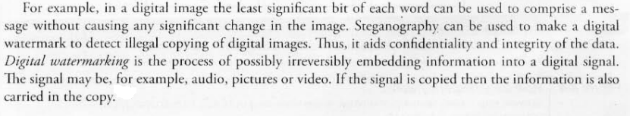
Steganography
It is a method that attempts to hide the existence of a message or communication.
The word “steganography” comes from the two Greek words: steganos meaning “covered” and graphein meaning “to write” that means “concealed writing.”
The different names for steganography are data hiding, information hiding and digital watermarking.
Steganalysis
Steganalysis is the art and science of detecting messages that are hidden in images, audio/video files using steganography.
Automated tools are used to detect such steganographed data/information hidden in the image and audio and/or video files.

Slide 49
DoS and DDoS Attacks
A denial-of-service attack (DoS attack) or distributed denial-of-service attack (DDoS attack) is an attempt to make a computer resource unavailable to its intended users.
DoS Attacks
The attacker floods the bandwidth of the victim’s network or fills his E-Mail box with Spam mail depriving him of the services he is entitled to access or provide.
The goal of DoS is not to gain unauthorized access to systems or data, but to prevent intended users (i.e., legitimate users) of a service from using it.
1. Flood a network with traffic, thereby preventing legitimate network traffic.
2. Disrupt connections between two systems, thereby preventing access to a service.
3. Prevent a particular individual from accessing a service.
4. Disrupt service to a specific system or person.

Slide 50
DDoS Attacks
In a DDoS attack, an attacker may use your computer to attack another computer.
By taking advantage of security vulnerabilities or weaknesses, an attacker could take control of your computer.
He/she could then force your computer to send huge amounts of data to a website or send Spam to particular E-Mail addresses.
A DDoS attack is a distributed DoS wherein a large number of zombie systems are synchronized to attack a particular system. The zombie systems are called “secondary victims” and the main target is called “primary victim.”
DDoS attacks involves hardcoding the target IP address prior to release of the malware, hence no further interaction is necessary to launch the attack.
A system may also be compromised with a Trojan, allowing the attacker to download a zombie agent.
How to Protect from DoS/DDoS Attacks
1. Implement router filters.
2. If such filters are available for your system, install patches to guard against TCP SYN flooding.
3. Disable any unused or inessential network service.
4. Enable quota systems on your OS if they are available.
5. Observe your system’s performance and establish baselines for ordinary activity
6. Routinely examine your physical security with regard to your current needs.
7. Use Tripwire or a similar tool to detect changes in configuration information or other files.
8. Invest in and maintain “hot spares” – machines that can be placed into service quickly if a similar machine is disabled.
9. Invest in redundant and fault-tolerant network configurations.
10. Establish and maintain regular backup schedules and policies, particularly for important configuration information.
11. Establish and maintain appropriate password policies, especially access to highly privileged accounts such as Unix root or Microsoft Windows NT Administrator.

Slide 51
SQL Injection
SQL stands for Structured Query Language. SQL lets you access and manipulate databases.
SQL injection is a code injection technique that exploits a security vulnerability occurring in the database layer of an application.
The vulnerability is present when user input is either filtered incorrectly for string literal escape characters embedded in SQL statements or user input is not strongly typed and thereby unexpectedly executed.
Attackers target the SQL servers – common database servers used by many organizations to store confidential data.
During an SQL injection attack, Malicious Code is inserted into a web form field or the website’s code to make a system execute a command shell or other arbitrary commands.
Just as a legitimate user enters queries and additions to the SQL database via a web form, the attacker can insert commands to the SQL server through the same web form field.
Blind SQL Injection
Blind SQL injection is used when a web application is vulnerable to an SQL injection but the results of the injection are not visible to the attacker.
The page with the vulnerability may not be the one that displays data; however, it will display differently depending on the results of a logical statement injected into the legitimate SQL statement called for that page.

Slide 52
Using SQL injections, attackers can:
1. Obtain some basic information if the purpose of the attack is reconnaissance
2. May gain access to the database by obtaining username and their password
3. Add new data to the database
4. Modify data currently in the database
How to Prevent SQL Injection Attacks
SQL injection attacks occur due to poor website administration and coding. The following steps can be taken to prevent SQL injection.
Input validation
Modify error reports
3. Other preventions
The default system accounts for SQL server 2000 should never be used.
Isolate database server and web server. Both should reside on different machines.
Most often attackers may make use of several extended stored procedures such as xp_cmdshell and xp_grantlogin in SQL injection attacks. In case such extended stored procedures are not used or have unused triggers, stored procedures, user-defined functions, etc., then these should be moved to an isolated server.

Slide 53
Buffer Overflow
Buffer overflow occurs when a program or process tries to store more data in a buffer (temporary data storage area) than it was intended to hold.
As buffers are created to contain a finite amount of data, the extra information can overflow into adjacent buffers, corrupting or overwriting the valid data held in them.
Although it may occur accidentally through programming error, buffer overflow is an increasingly common type of security attack on data integrity.
Types of Buffer Overflow
Stack-Based Buffer Overflow
Stack buffer overflow occurs when a program writes to a memory address on the program’s call stack outside the intended data structure – usually a fixed length buffer.
The attacker may exploit stack-based buffer overflows to manipulate the program in various ways by overwriting.
NOPs
NOP or NOOP (no operation performed) is an assembly language which enables the developer to force memory alignment to act as a place holder to be replaced by active instructions later on in program development.
NOP opcode can be used to form an NOP slide, which allows code to execute when the exact value of the instruction pointer is indeterminate.
Heap Buffer Overflow
Heap buffer overflow occurs in the heap data area when an application copies more data into a buffer than the buffer was designed to contain.

Slide 54
How to Minimize Buffer Overflow
The following methods will definitely help to minimize such attacks:
Assessment of secure code manually
Disable stack execution
Compiler tools
Dynamic run-time checks
Various tools are used to detect/defend buffer overflow
Attacks on Wireless Networks
Even when people travel, they still need to work.
The employee is no longer tied to an office location and is, in effect, “boundaryless.”
The following are different types of “mobile workers”:
Tethered/remote worker
Roaming user
Nomad
Road warrior
Wireless networks extend the range of traditional wired networks by using radio waves to transmit data to wireless-enabled devices such as laptops and PDAs.
Wireless networks are generally composed of two basic elements:
access points (APs)
other wireless-enabled devices, such as laptops radio transmitters and receivers to communicate or “connect” with each other (see Fig. 1).

Slide 55
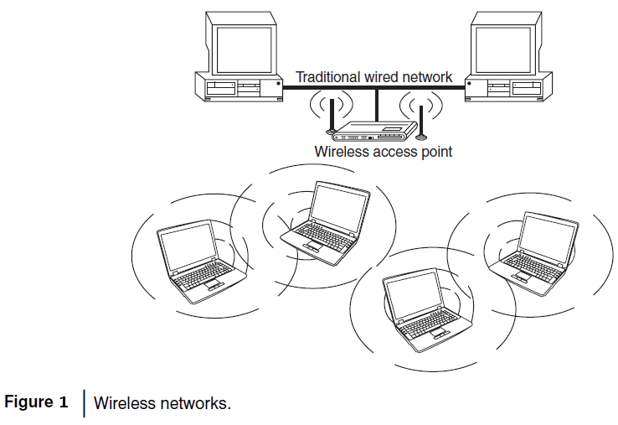

Slide 56
Traditional Techniques of Attacks on Wireless Networks
Penetration of a wireless network through unauthorized access is termed as wireless cracking.
There are various methods that demand high level of technological skill and knowledge, and availability of numerous software tools made it less sophisticated with minimal technological skill to crack WLANs.
Sniffing
Spoofing
Denial of service (DoS)
Man-in-the-middle attack (MITM)
Encryption cracking
Theft of Internet Hours and Wi-Fi-based Frauds and Misuses
Wireless network into homes enables the Internet on the finger tip of home users.
In case, unfortunately, he/she visits a malicious webpage, the router is exposed for an attack.
As the networks become stronger and more prevalent, more of the signals are available outside the home of the subscriber, spilling over into neighbor’s apartments, hallways and the street.
Be careful with use of WAPs; when you are using a WAP to gain access to computer on a network
be aware of the local laws/legislations where you are doing it because things can become dangerous from security and privacy as well legal perspective.

Slide 57
How to Secure the Wireless Networks
Following summarized steps will help to improve and strengthen the security of wireless network:
1. Change the default settings of all the equipments/components of wireless network (e.g., IP address/ user IDs/administrator passwords, etc.).
2. Enable WPA/WEP encryption.
WEP stands for Wired Equivalent Privacy, and WPA stands for Wireless Protected Access. WPA2 is the second version of the WPA standard. Using some encryption is always better than using none, but WEP is the least secure of these standards, and you should not use it if you can avoid it.
3. Change the default SSID.
4. Enable MAC address filtering.
5. Disable remote login.
6. Disable SSID broadcast.
7. Disable the features that are not used in the AP (e.g., printing/music support).
8. Avoid providing the network a name which can be easily identified (e.g., My_Home_Wifi ).
9. Connect only to secured wireless network (i.e., do not autoconnect to open Wi-Fi hotspots).
10. Upgrade router’s firmware periodically.

Slide 58
Questions
What are the basic stages of an attack?
What is proxy server? Describe its functions
Describe the process of password cracking.
How can keyloggers be used to commit a cybercrime?
Describe online attacks, offline attacks, strong passwords, random passwords
What is the difference between a virus and a worm?

Slide 59
Questions
What is SQL injection and what are the different counter measures to prevent the attack?
How to Protect from DoS/DDoS Attacks? Explain in detail
Differentiate between hoax mails and spam.
Explain with a diagram about Attacks on Wireless Networks.
Explain the difference between Trojan horses and backdoors?
How to Secure the Wireless Net
Explain in detail on Theft of Internet Hours and Wi-Fi-based Frauds and Misuses

